Slide 1

Advocate Now
Connecting You with Legal Experts,
Anytime, Anywhere.
Supervisor: Sir Rizwan Abro

Slide 2



Group Members
Ali Khan
Atif Malik

Slide 3
INTRODUCTION
Advocate Now is a mobile application designed to connect clients with experienced lawyers.
Providers an easy-to-use platform for searching, booking and consulting lawyers.
Addresses challenges like limited access to legal professionals, lack of visibility for lawyers, and absence of virtual legal consultation platforms.
Enables secure video consultations, appointment scheduling, and integrated payment processing.
Uses Flutter for cross-platform development and Firebase for backend support.
Aims to improve legal service accessibility for both clients and advocates.

Slide 4
Objectives :
01
02
03
04
Enhance Access to Legal Services – Provide an easy-to-use platform for finding and consulting with lawyers.
Improve Efficiency – Enable users to book and manage appointments without visiting a lawyer’s office
.
Increase Lawyer Visibility – Help legal professionals showcase their expertise and connect with clients.
Enable Virtual Consultations – Support video, audio, and chat-based legal consultations.
05
Ensure Data Security & Privacy – Protect user data with encryption and secure authentication.

Slide 5
System Overview :
Core Components :
User Module: Registration, login, and profile management.
Lawyer Module: Profile creation, appointment handling, and virtual consultation.
Appointment Management: Scheduling and notifications.
Payment System: Secure payment processing via Easy-paisa/Jazz-cash
Workflow :
User register/Login :-> Search lawyers, views lawyers profile
User Schedules an appointment :-> video consultation
User makes payment :-> Transaction is verified
Lawyers join sessions :-> Virtual consultation

Slide 6
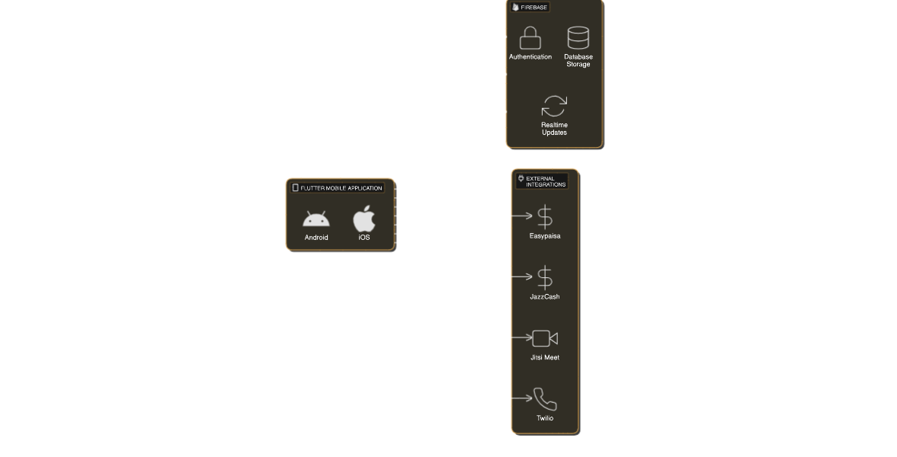
Architecture Diagram

Slide 7
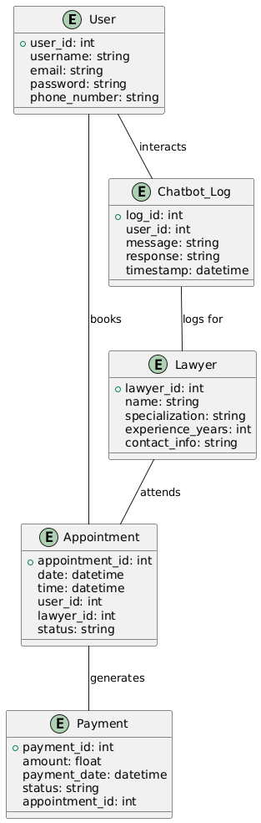
ER Diagram

Slide 8
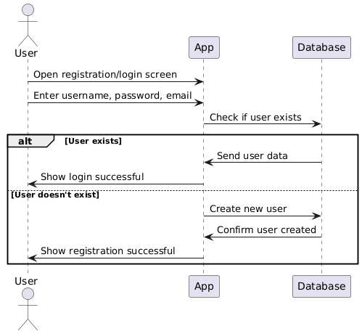
Sequence Diagram

Slide 9
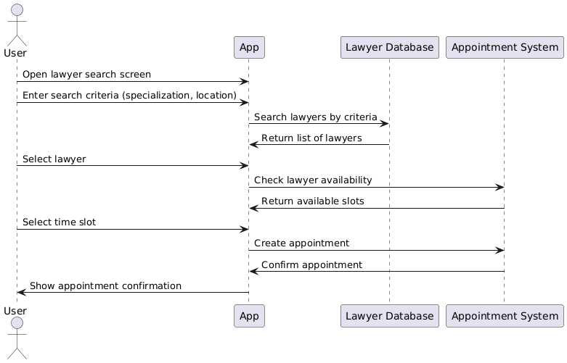
Sequence Diagram

Slide 10
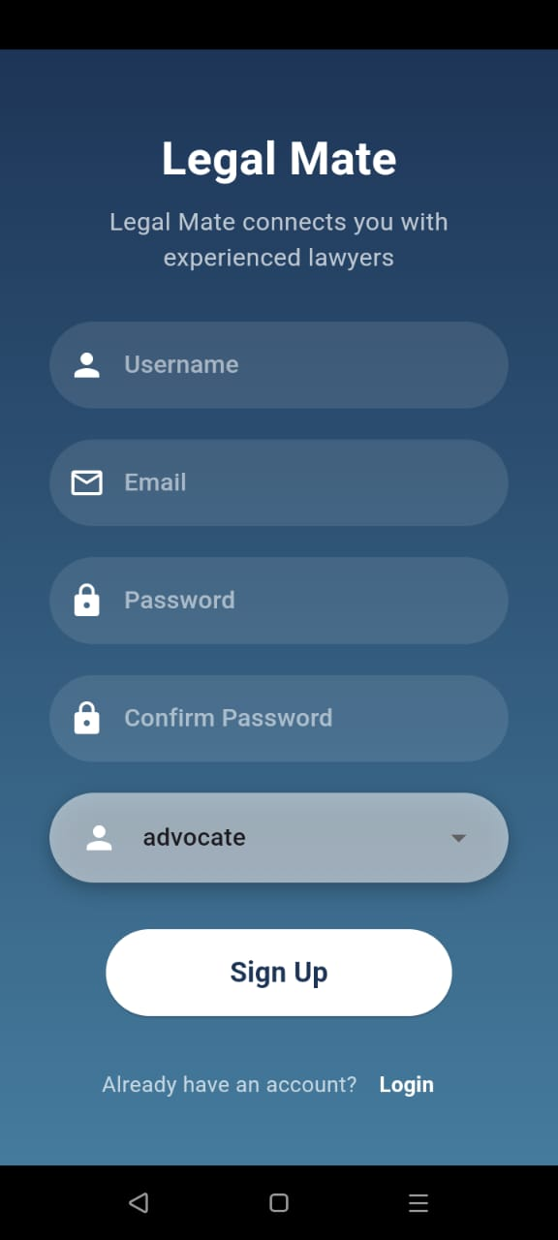
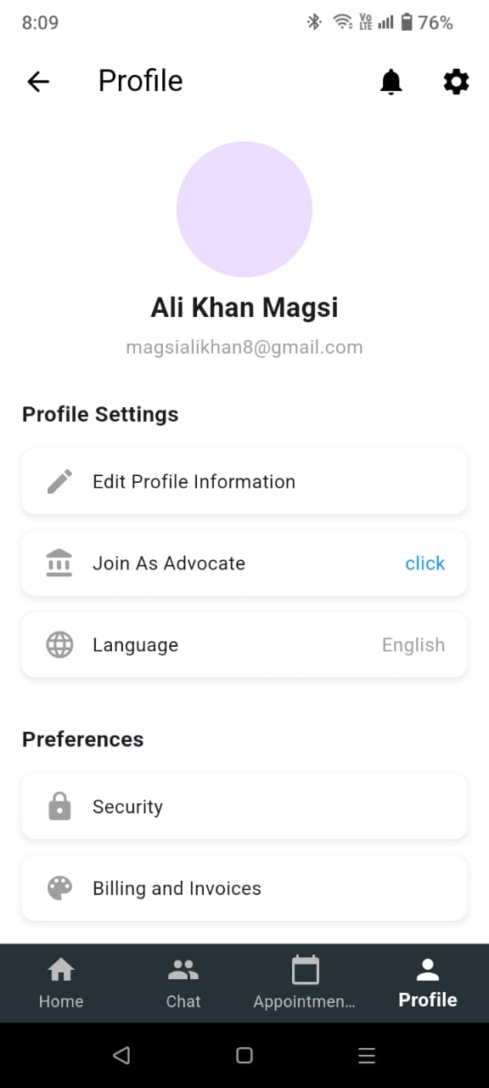
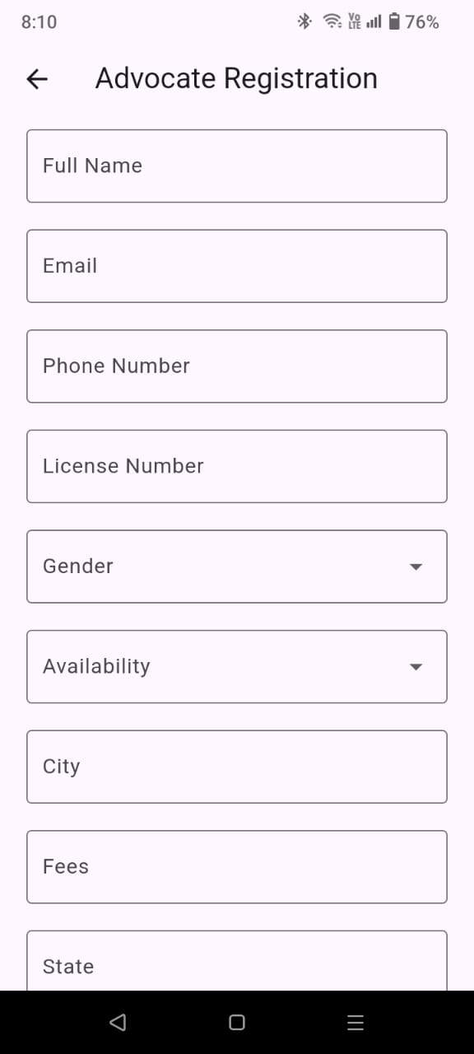

Slide 11
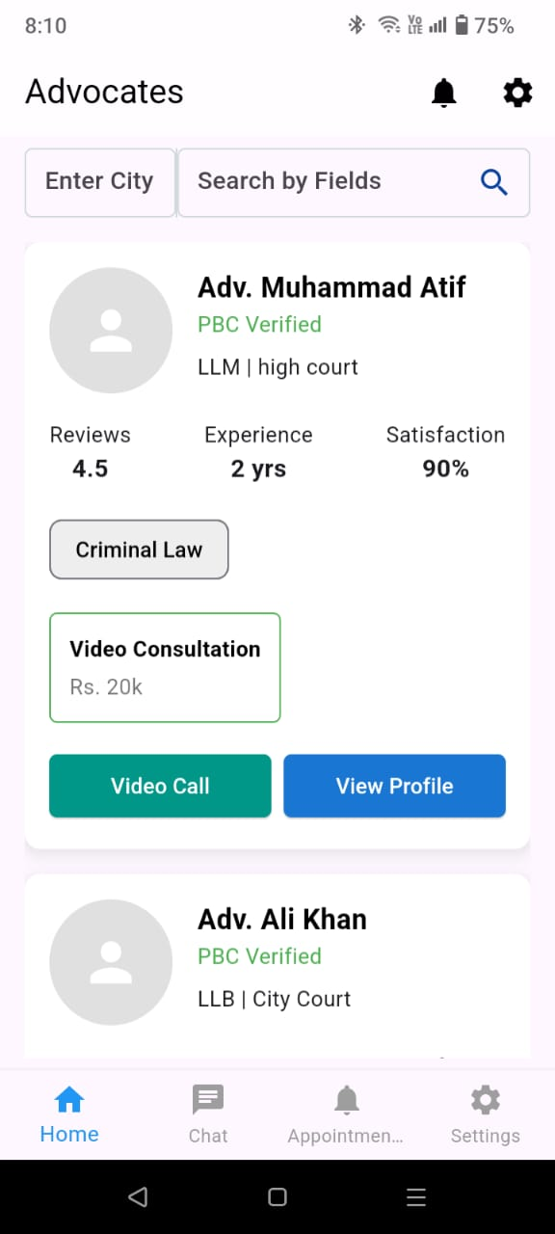
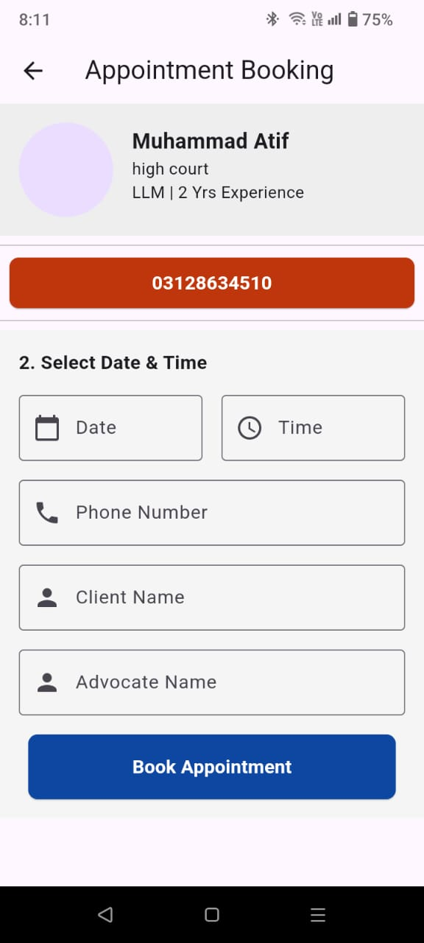
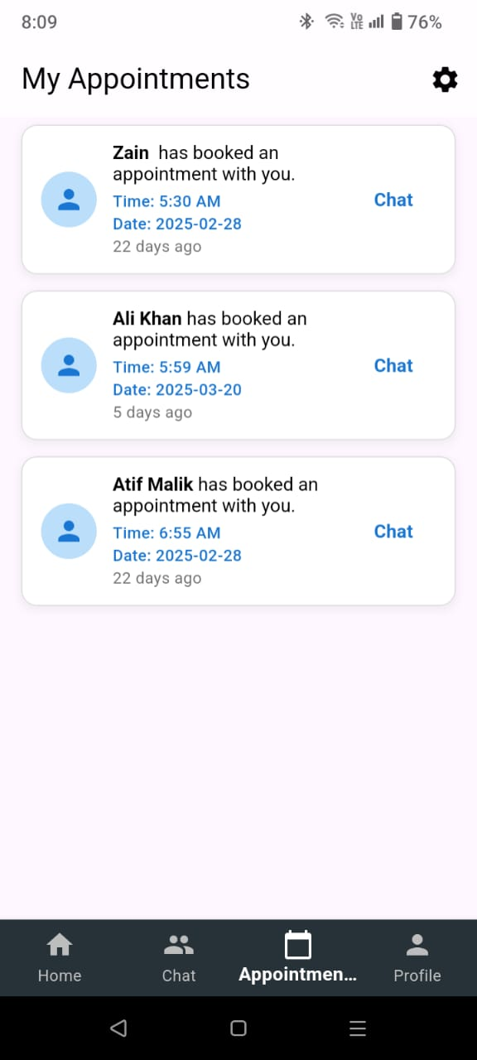

Slide 12
Benefits of this project :
Easy Access to Legal Services -> User can find and consult lawyer from anywhere.
Time-Saving -> No need physical visit, appointments and consultations and handled online.
Better Lawyer Visibility -> Helps lawyers showcase their expertise and reach more clients.

Slide 13
Thankyou Somuch

